Slide 1
Expression tree
Osama Hameed - 22737
Muhammad Sumair - 22995
Khansa Junaid - 23074

Slide 2
Data Structures Used:
Generic Stacks
Binary Trees

Slide 3
There are three types of expression formats:
1.Infix expression(In-order):
In infix notation, e.g. a - b + c, where operators are used in-between operands.
2.Postfix expression(Post-order):
In Postfix , operators are postfixed to operands, i.e operator is written ahead of operands,
3.Prefix expression(Pre-order):
In Prefix, Operator is prefixed to operands, i.e. operator is written ahead of operands. For example, +ab. This is equivalent to its infix notation a + b.

Slide 4
Why computers uses postfix notation?
In postfix notation, we don’t have to deal with things like operator precedence ever—at all. This makes evaluation simple and straightforward.
Also formulas can be written without parenthesis, with no operator precedence, and right and left associativity are also not taken in to consideration.
These can be evaluated as two operands and an operator at a time, this becomes easier for the compiler and the computer to handle and evaluate, and also in a short time.

Slide 5
Postfix Notation
This notation style is also called reversed polish notation.
Postfix form is basically operand>operand>operator.
And in this form there are no parenthesis required.
Standard expression(infix)=a ∗ (b + c) to postfix expression=a b c + ∗.
There are two ways to get postfix expressions, we an directly convert infix expression to postfix and also by post order traversal of expression tree postfix expression can be obtained.
The compiler scans expression from left to right or right to left, in this process operators precedence must also be taken in to consideration and will make it in efficient. So converting expression in to postfix will make it easier for the compiler to evaluate.

Slide 6
Infix
Postfix
To parse expressions we need to take care of operator precedence and associativity also. When an operand is in between two different operators, which operator will take the operand first, is decided by the precedence of an operator over others. Associativity describes the rule where operators with the same precedence appear in an expression.
1. Scan the infix expression from left to right. 2. If the scanned character is an operand, output it. 3. Else, 1 If the precedence of the scanned operator > precedence of the operator in the stack(or the stack is empty or the stack contains a ‘(‘ ), push it. 2 Else, Pop all the operators from the stack which are greater than or equal to in precedence than that of the scanned operator. After doing that Push the scanned operator to the stack. (If you encounter parenthesis while popping then stop there and push the scanned operator in the stack.) 4. If the scanned character is an ‘(‘, push it to the stack. 5. If the scanned character is an ‘)’, pop the stack and output it until a ‘(‘ is encountered, and discard both the parenthesis. 6. Repeat steps 2-6 until infix expression is scanned. 7. Print the output 8. Pop and output from the stack until it is not empty.

Slide 7
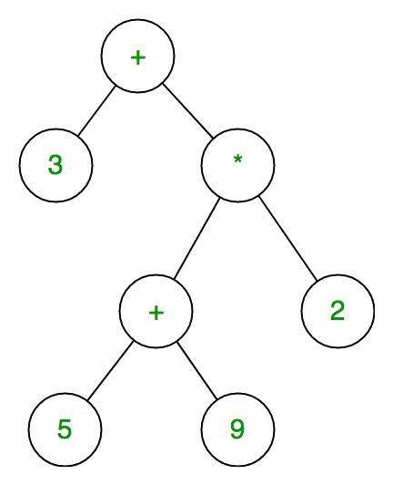
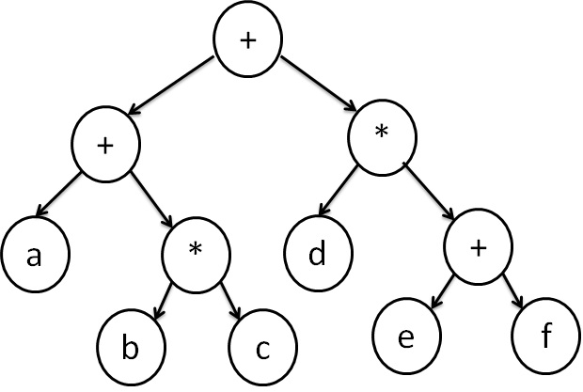
Expression Trees
Expression tree is the representation of the expressions in a tree like structure.
It is the special kind of binary tree in which leaf nodes correspond to operands and root and internal nodes are operators for a+(b*c)+d*(e+f) expression tree would be:

Slide 8
Postfix
Expression Tree
Push operands on a stack as leaf-nodes, not bound to any tree in any direction
For operators, pop the necessary operands off the stack, create a node with the operator at the top, and the operands hanging below it, push the new node onto the stack

Slide 9
Time Complexities for Expression Tree
METHOD | WORST CASE
MakeExpressionTree() | O(n)
GiveInfixExpression() | O(n)
GivePostfixExpression() | O(n)
Evaluate() | O(n)

Slide 10
Time Complexities for InfixToPostfixConvertor and Stacks
METHOD | WORST CASE
ConvertToPostfix() | O(n)
Push() | O(1)
Pop() | O(1)
Peek() | O(1)

Slide 11
References
https://runestone.academy/runestone/books/published/pythonds/BasicDS/InfixPrefixandPostfixExpressions.html
https://www.cct.lsu.edu/~sidhanti/tutorials/data_structures/page262.html
https://www.cct.lsu.edu/~sidhanti/tutorials/data_structures/page265.html#SECTION0010503000000000000000
https://www.krivalar.com/data-structures-expression-tree

